Slide 1

DIABETIC RETINOPATHY DETECTION USING RESNET101 AND DENSENET121
MALLA REDDY ENGINEERING COLLEGE
PRESENTED BY:-
22J41A05J7 - SHIKARI GANESH
22J41A05F6 - GUVVALA KIRAN KUMAR
22J41A05J9 - TELUGU UDAY KUMAR
22J41A05G8 - KURMA SRI CHARAN

Slide 2
CONTENTS
Abstract
INTRODUCTION
PROBLEM STATEMENT
TOOLS AND TECHNOLOGIES USED
LITERATURE SURVEY
METHODOLOGY-OVER VIEW
Data Collection and Preprocessing
Model Selection
Model Training
Model Evaluation
User Interface Development
APPLICATIONS
ADVANTAGES
FUTURE SCOPE
CONCLUSION

Slide 3
ABSTRACT
The project detects Diabetic Retinopathy (DR) using retinal images to prevent blindness through early diagnosis.
It uses deep learning models ResNet101 and DenseNet121 for classifying different stages of DR.
Images are preprocessed, and models are trained and evaluated using accuracy, precision, recall, and F1 score.
A Tkinter GUI allows users to upload images, run predictions, and view DR stage results.

Slide 4
Introduction
Developed an AI-based system using ResNet101 and DenseNet121 to detect and classify diabetic retinopathy (DR) from retinal images.
Aims to automate diagnosis, reducing human error and enabling early detection of DR.
Designed a GUI using Tkinter for easy image upload, model prediction, and result visualization.

Slide 5
Problem Statement
Manual detection of Diabetic Retinopathy (DR) is time-consuming and prone to human error, especially in areas with limited medical access.
There's a need for an automated, accurate, and user-friendly system to detect and classify DR stages from retinal images.

Slide 6
Tools and Technologies Used
Python – Programming language
TensorFlow & Keras – Deep Learning Frameworks
ResNet101 & DenseNet121 – CNN Architectures
Tkinter – GUI Development
Jupyter Notebook / Google Colab – Model Training & Testing
Matplotlib & Seaborn – Visualization Tools
Pandas & NumPy – Data Handling Libraries

Slide 7
Literature Survey
Many studies use CNNs for accurate retinal image classification in diabetic retinopathy.
Research shows ResNet101 improves detection by handling deep layers efficiently.
DenseNet121 achieves better performance by promoting feature reuse and minimizing parameters.
Existing systems often lack user-friendly interfaces for non-experts.
Our project bridges this gap using deep learning + GUI for early, accessible DR detection.

Slide 8
Methodology - Overview
Data Collection and Preprocessing
Model Selection
Model Training
Model Evaluation
User Interface Development

Slide 9
Data Collection and Preprocessing
Gather a dataset of retinal images from sources like Kaggle.
Preprocess images by resizing, normalizing pixel values, and augmenting data to enhance model robustness.
Split the dataset into training (80%) and testing (20%) sets for model evaluation.

Slide 10
Model Selection
Choose two deep learning architectures: ResNet101 and DenseNet121.
ResNet101 utilizes residual learning to mitigate the vanishing gradient problem, allowing for deeper networks.
DenseNet121 employs dense connections to improve feature reuse and enhance model performance.

Slide 11
Model Training
Train both models using the preprocessed training dataset.
Utilize techniques like transfer learning to leverage pre-trained weights for faster convergence and improved accuracy.
Monitor training performance using metrics such as accuracy, loss, precision, and recall.

Slide 12
Model Evaluation
Evaluate the trained models on the testing dataset.
Generate confusion matrices and performance metrics (accuracy, precision, recall, F1 score) to assess model effectiveness.
Compare the performance of ResNet101 and DenseNet121 to determine the best-performing model.

Slide 13
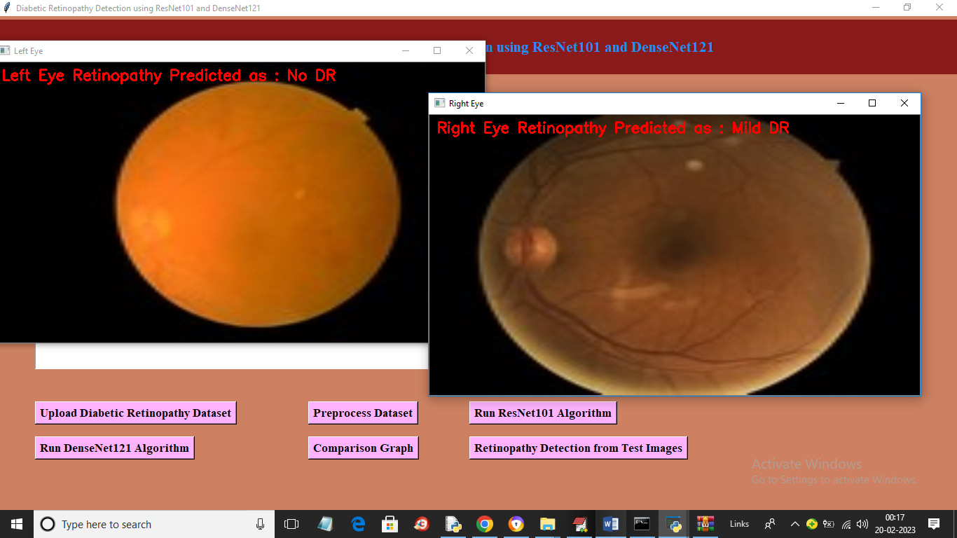
User Interface Development
Develop a user-friendly graphical user interface (GUI) using Tkinter.
Allow users to upload retinal images, run predictions, and visualize results.
Integrate functionalities for displaying evaluation metrics and confusion matrices for better insights into model performance.

Slide 14
Applications
Automated Screening
Early Diagnosis
Telemedicine
Integration with Health Systems
Research and Development

Slide 15
Advantages
High Accuracy
Automation
Early Detection

Slide 16
Future Scope
Use better deep learning methods to make eye disease detection more accurate.
Add AI to wearable devices to keep checking eye health in diabetic patients.
Use AI to study patient data and suggest treatment based on their condition.
Improve AI to find other eye problems and give better overall eye care.

Slide 17
Conclusion
The Diabetic Retinopathy Detection System uses ResNet101 and DenseNet121 for accurate detection in retinal images.
It helps diagnose different stages of diabetic retinopathy, enhancing healthcare professionals' capabilities.
Key features include dataset preprocessing, model training, evaluation, and prediction, with performance visualization.
The comparison between ResNet101 and DenseNet121 helps choose the best model for specific datasets.
A user-friendly Tkinter interface allows clinicians to make informed decisions, improving patient outcomes and healthcare efficiency.

Slide 18
THANK YOU

